Slide 1


Our Application
Presented by:
Zeina Esam Zyada
Marina Malak Mazoz
ITI project

Slide 2
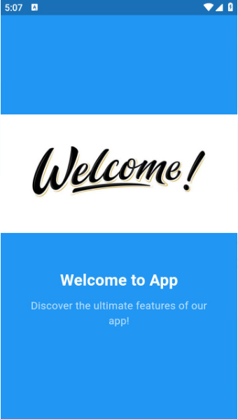
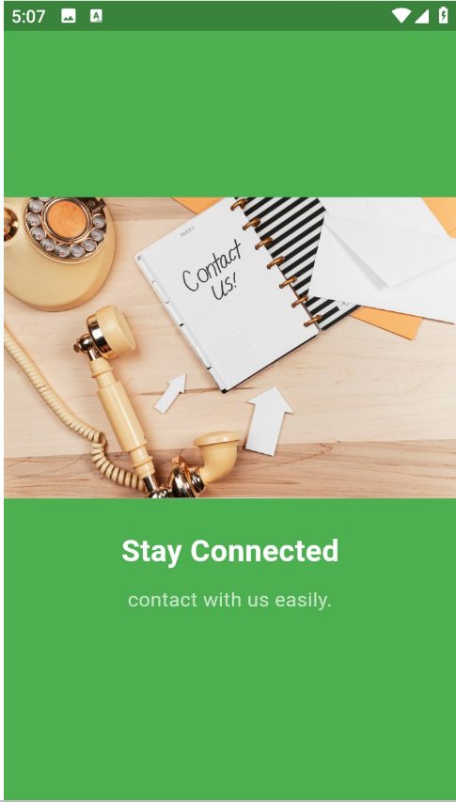
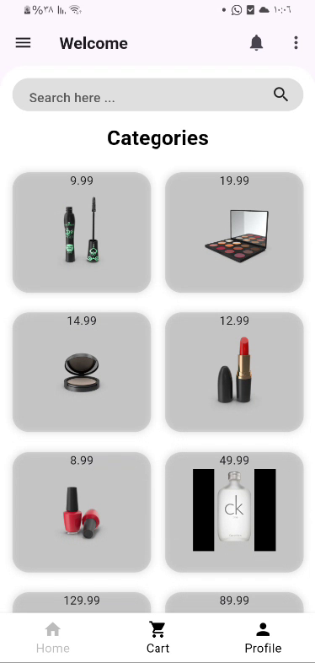
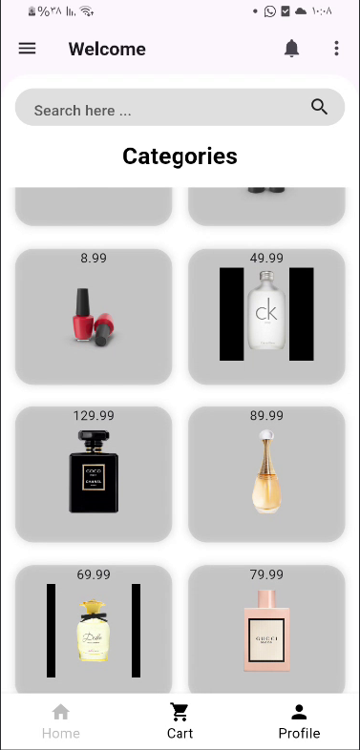
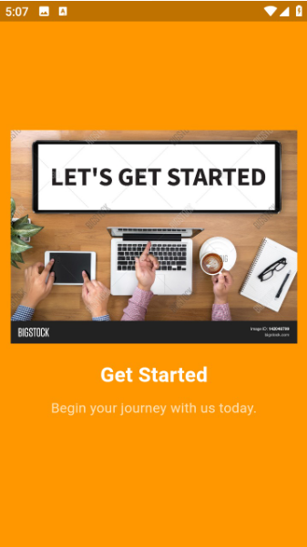
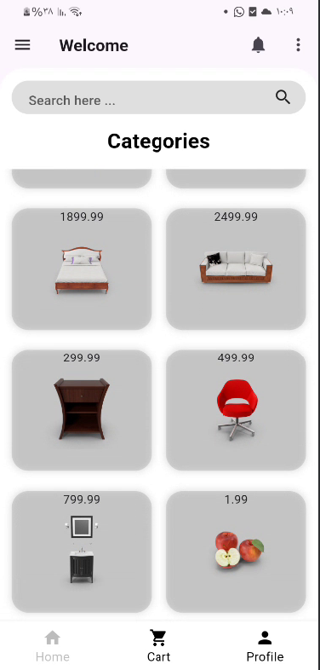
1)Onboarding screen

Slide 3
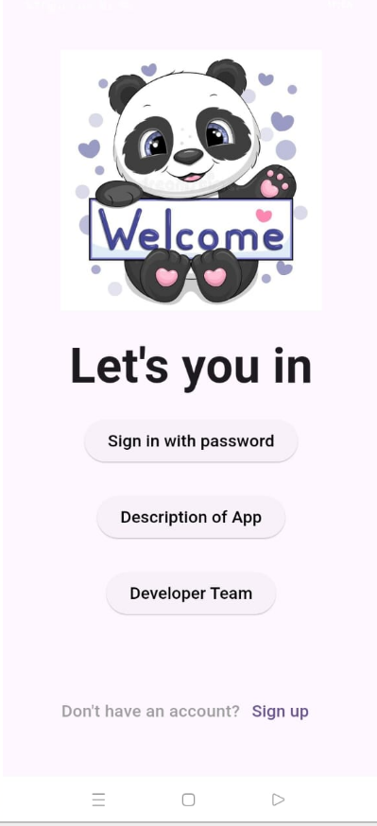
2) Our welcome screen
1
You can create your account or login with your name and password
2
Know more about our application description
3
The developer team

Slide 4
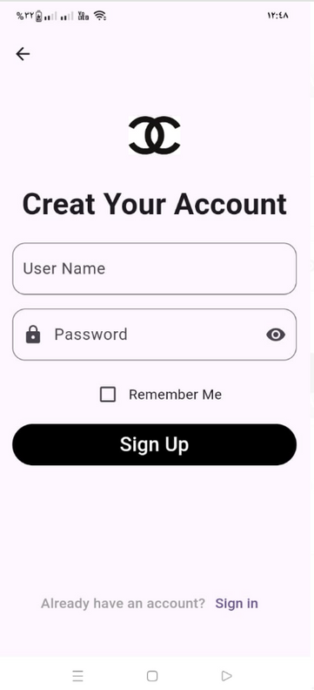
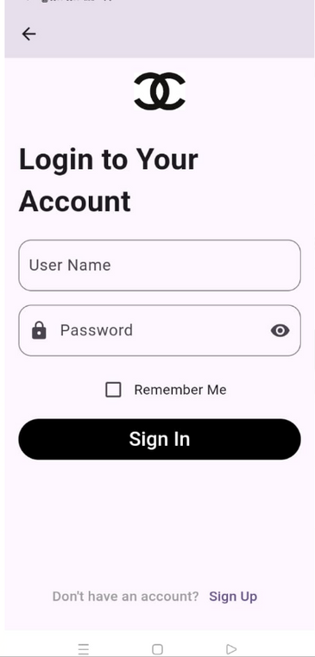
3) login to our application
1
You can create a new account then sign up
2
You can login with your account using your name and password then sign in

Slide 5
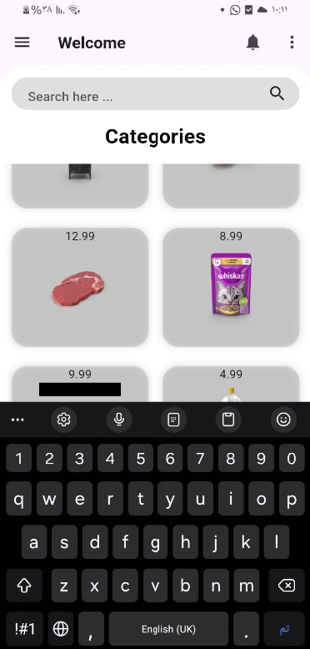
4)Our home page
1
You can find what you need by searching
2
There are many different categories such as makeup ,perfumes , furniture , etc...

Slide 6
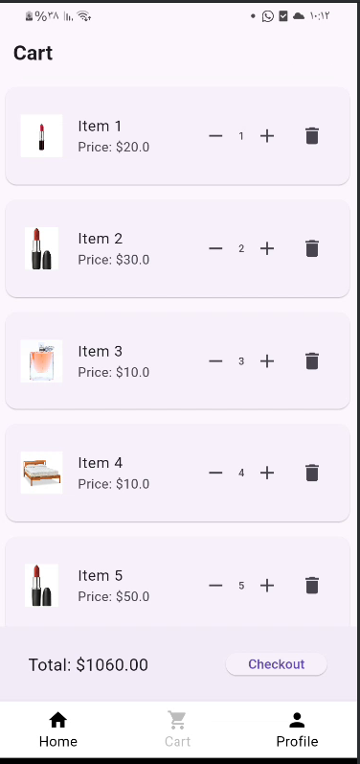
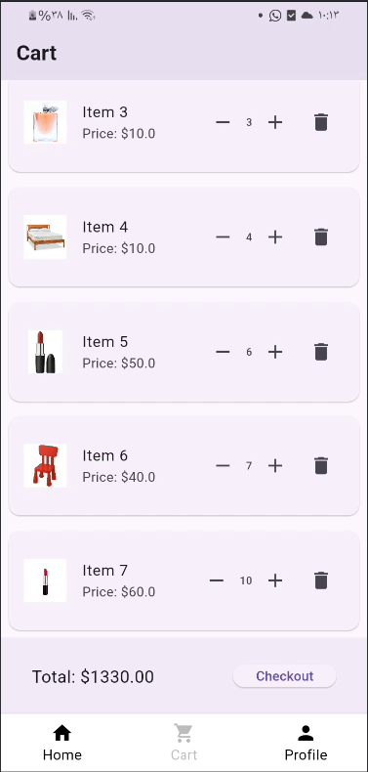
5) Cart page
You can adjust the quantity of items , remove items and proceeds to checkoot to complete your purchase

Slide 7
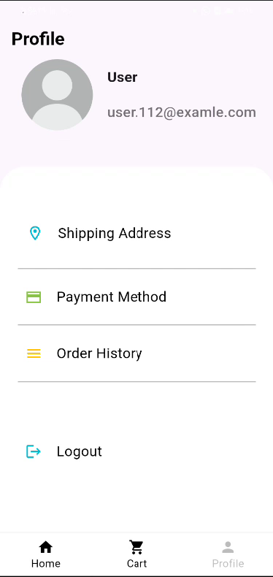
6)Profile Page

Slide 8
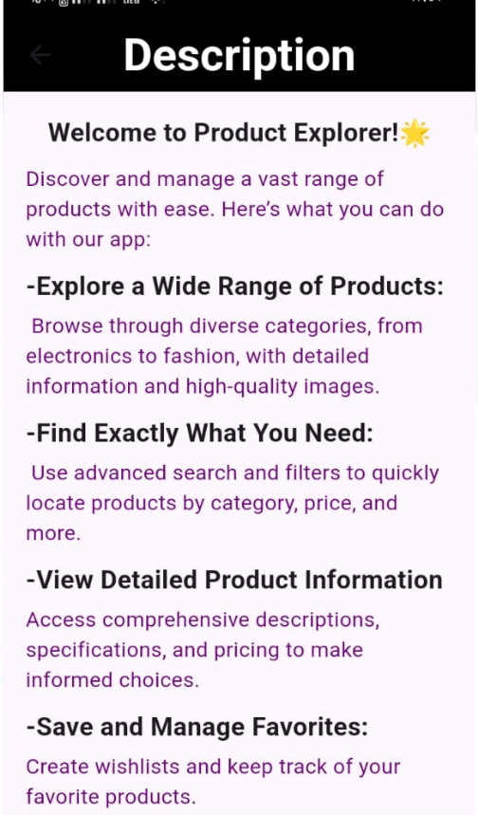
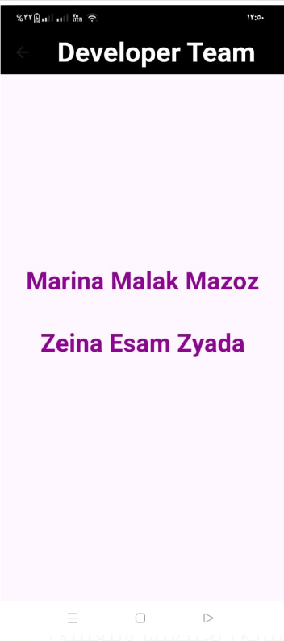

Developer Team
Description

Slide 9
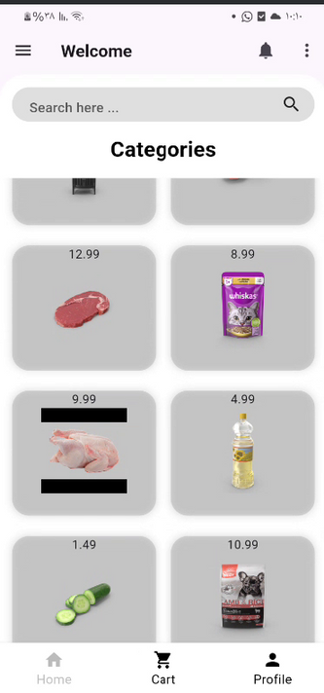
Thank You

